Slide 1
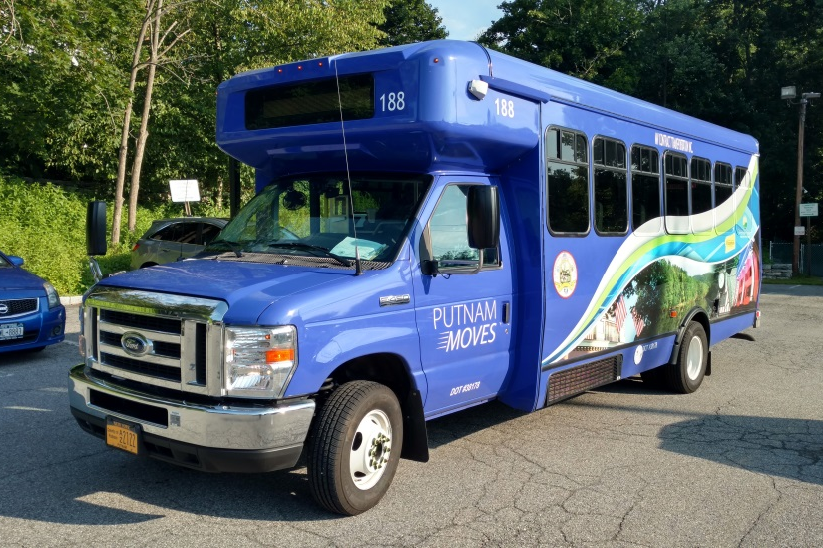
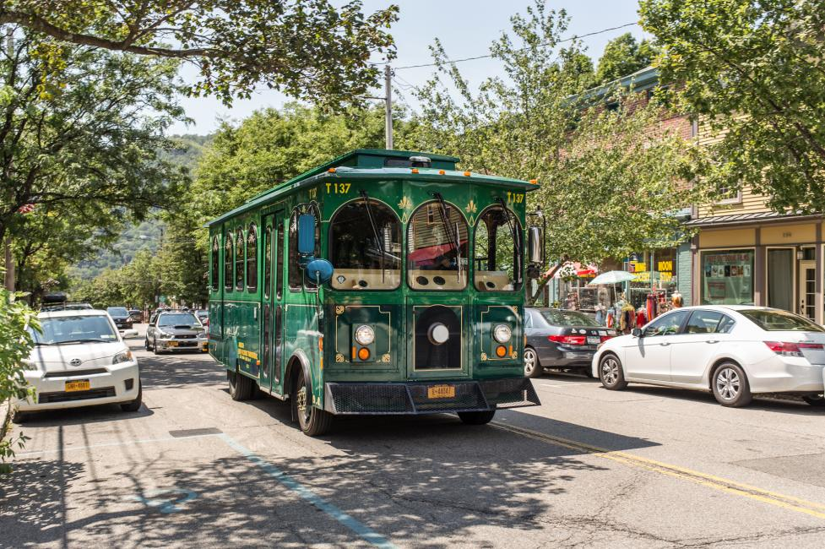
Putnam County Transportation 2019 Report
July 23, 2019
Putnam County Department of Planning,
Development & Public Transportation

Slide 2
Outline
MV Contract & Modern Fleet
PART Fixed Route
Croton Falls Shuttle
Cold Spring Trolley
Putnam Valley Shuttle
Paratransit
Ridership Trends
Total Cost, Ridership & Cost/Ride 2012 – 2019
Pre-K & E.I.E.
Veterans Transportation – OSR RSVP Program
Mobility Management
Questions

Slide 3
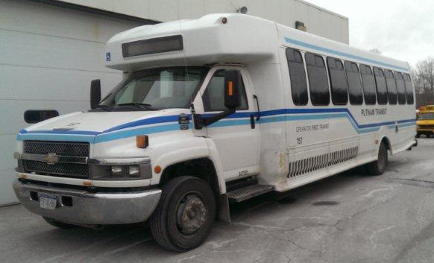
MV Transportation
In April, the contract with MV was extended to March 31, 2020.
As of January 2019, with purchase of new paratransit vehicles, Putnam County’s Transportation Fleet is modern and up to date and right-sized.
All of our fixed route buses and Paratransit vehicles are handicap accessible and 2017 or newer. (8 from 2017, 4 from 2018 and 4 from 2019)

Slide 4
PART Fixed Routes

Slide 5
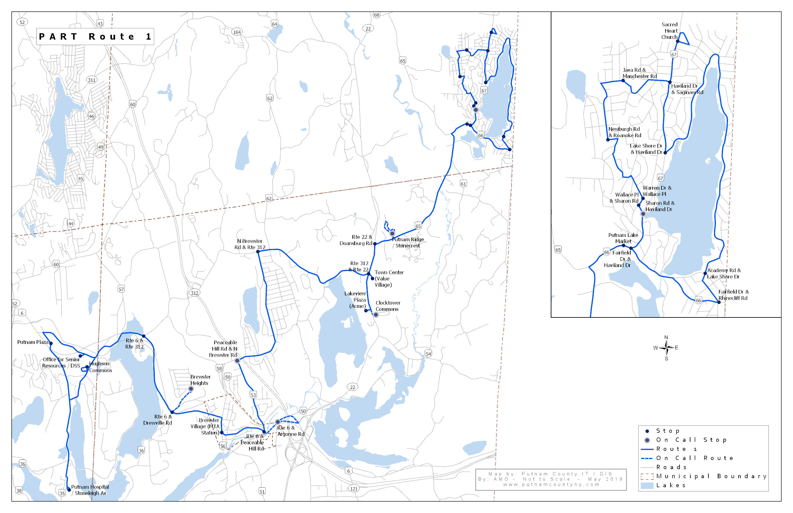
PART 1 | Cost | Cost/Ride | Ridership
2018 | $658,308 | $12.64 | 52,075
Brewster & Putnam Lake

Slide 6
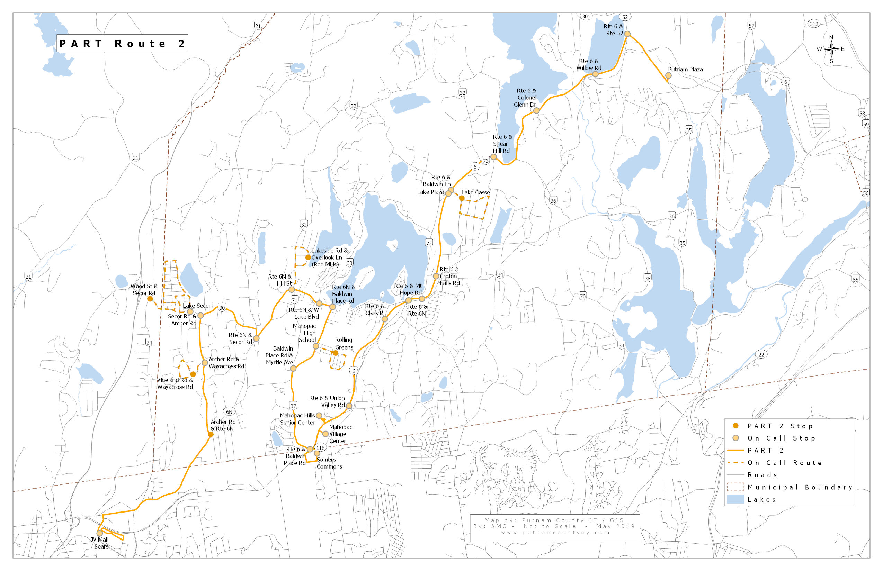
PART 2 | Cost | Cost/Ride | Ridership
2018 | $306,728 | $18.21 | 16,845
Mahopac

Slide 7
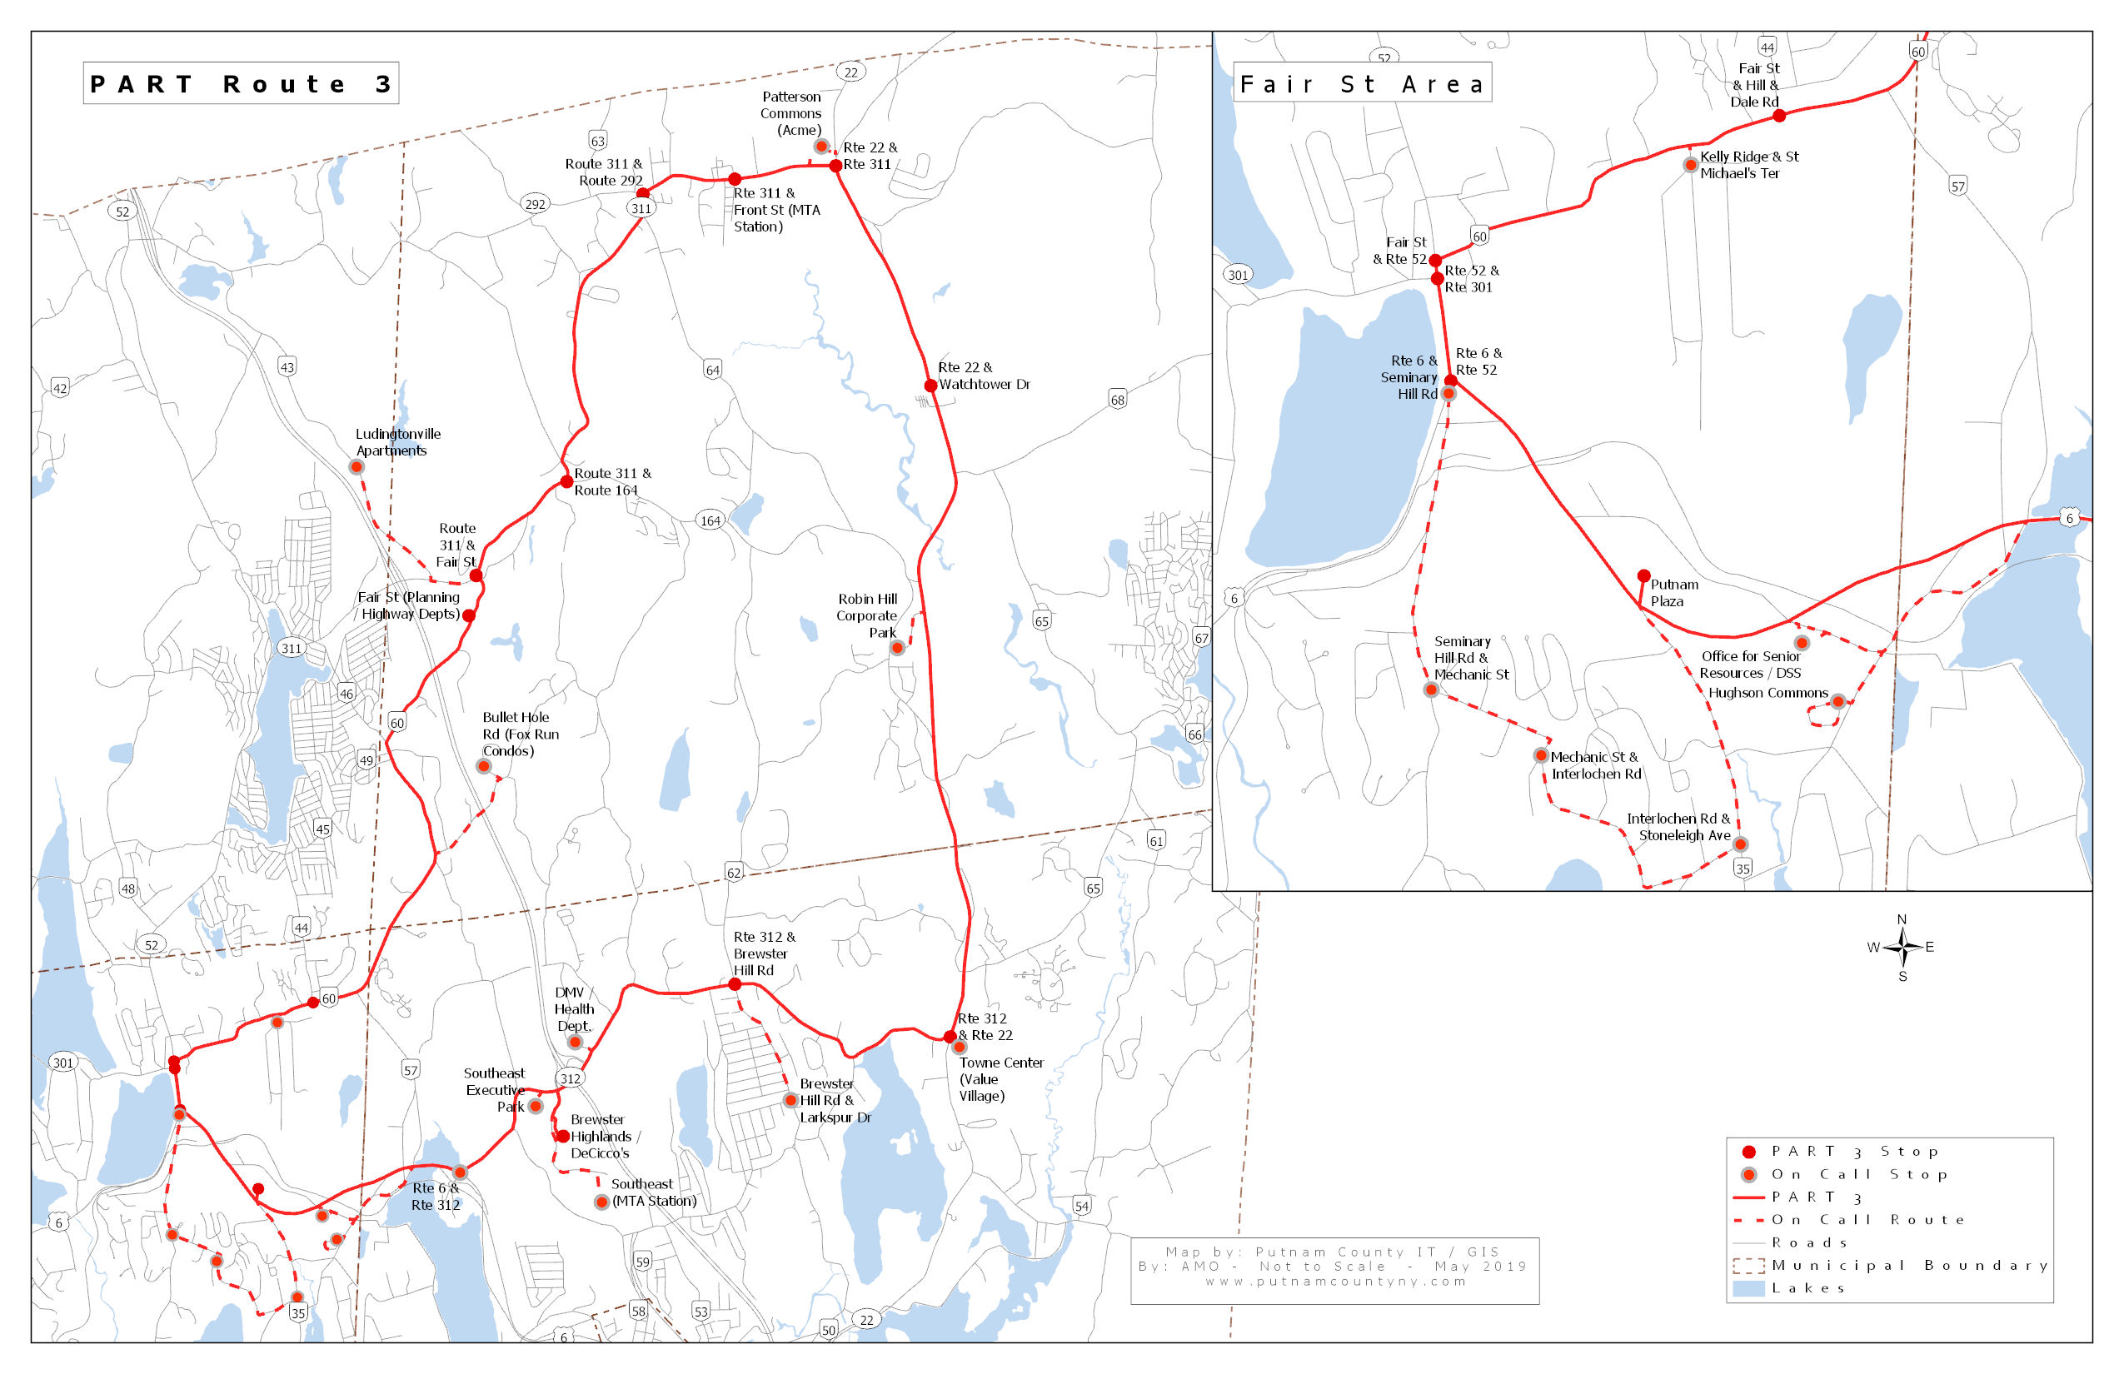
PART 3 | Cost | Cost/Ride | Ridership
2018 | $230,274 | $33.33 | 6,909
Patterson & Carmel

Slide 9
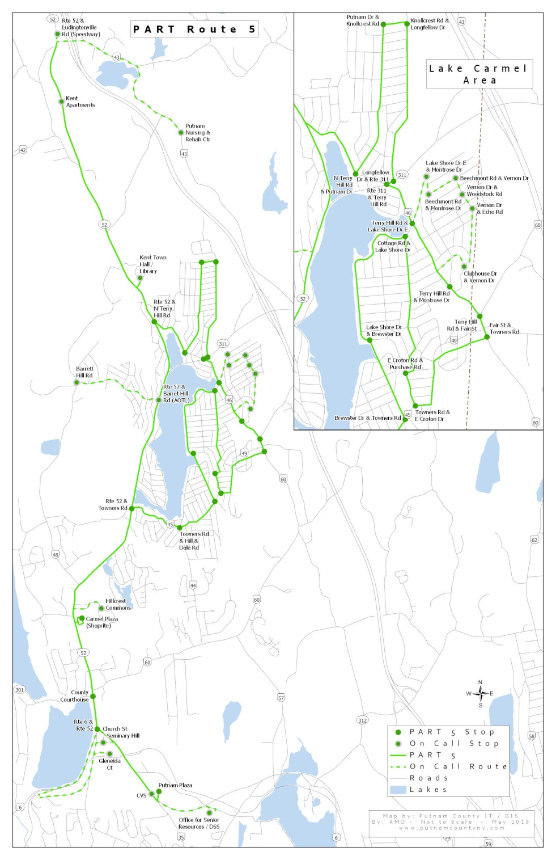
PART 5 | Cost | Cost/Ride | Ridership
2018 | $328,131 | $18.97 | 17,293
Lake Carmel & Kent

Slide 10
Fixed Route Flexibility
PART’s fixed routes have shown that the On Call system (where riders can call in pickups to certain locations that are off the fixed route but serves a ridership in need) is a successful way to increase access in a mainly rural county.
In recent years On Calls have been added including but not limited to several senior citizen housing developments, shopping plazas in Brewster and Patterson, and in the densely populated Lake Carmel area.
PART also enables connections outside of Putnam with transfers to Westchester and Connecticut’s HART service and of course Metro North Train Stations making PART a component of a greater regional network.

Slide 11
Croton Falls Shuttle
Partnerships with Metro North Railroad, MTA since 2016.
Year | Total Cost | Ridership | Cost/Ride
2016 | $201,121 | 13,155 | $15.29
2017 | $191,605 | 11,942 | $16.04
2018 | $205,310 | 10,694 | $19.20
Total | $598,036 | 35,791 | $16.84 (avg.)

Slide 12
Cold Spring Trolley
Partnerships with Putnam County Visitors Bureau, Cold Spring Chamber of Commerce and private stakeholders (Magazzino, Boscobel, Manitoga, etc.)
Year | Total Cost | Ridership | Cost/Ride
2012 | $45,127 | 2,383 | $18.94
2013 | $55,150 | 3,069 | $17.97
2014 | $34,343 | 2,118 | $16.21
2015 | $32,889 | 2,381 | $13.81
2016 | $23,268 | 1,590 | $14.63
2017 | $24,590 | 792 | $31.05
2018 | $28,596 | 1,527 | $18.73
Total | $243,963 | 13,860 | $18.76 (Avg.)

Slide 13
Putnam valley shuttle
Discontinued in February 2019.
Year | Total Cost | Ridership | Cost/Ride
2018 | $129,470.00 | 268 | $483.10
2019 | $12,839.95 | 12 | $1070.00
Total | $142,309.95 | 280 | $508.25

Slide 14
Total COST BREAKDOWN
Year | Total Cost | Ridership | Overall Cost/Ride | Notes
2012 | $ 2,327,826.00 | 168,331 | $13.83 | Fixed Route, Para, CS Trolley
2013 | $ 2,321,394.00 | 160,464 | $14.47 | Fixed Route, Para, CS Trolley
2014 | $ 2,456,553.00 | 144,151 | $17.04 | Fixed Route, Para, CS Trolley
2015 | $ 2,230,608.00 | 134,381 | $16.60 | Fixed Route, Para, CS Trolley
2016 | $ 2,389,708.00 | 143,681 | $16.63 | Croton Falls Shuttle added
2017 | $ 2,317,923.00 | 132,931 | $17.44
2018 | $ 2,398,868.00 | 120,711 | $19.87 | Putnam Valley Shuttle added
Total | $16,442,880.00 | 1,004,650 | $16.37 | Last 7 years (MV)

Slide 15
ADA Paratransit in recent years
2017
Paratransit Cost = $400,012
Paratransit Cost/Ride = $24.30
Paratransit Rides = 16,463
Eligible Riders = 471
Active Riders = 210
2018
Paratransit Cost = $410,851
Paratransit Cost/Ride = $27.21
Paratransit Rides = 15,100
Eligible Riders = 452
Active Riders = 212

Slide 16
ADA Paratransit Applications
Year | Received | Denied | Certified | Approved, & Pending
2015 | 88 | 0 | 73 | 15
2016 | 97 | 0 | 81 | 16
2017 | 101 | 0 | 77 | 24
2018 | 94 | 0 | 67 | 27
2019* | 76 | 0 | 58 | 18
*As of 7/15/2019

Slide 17
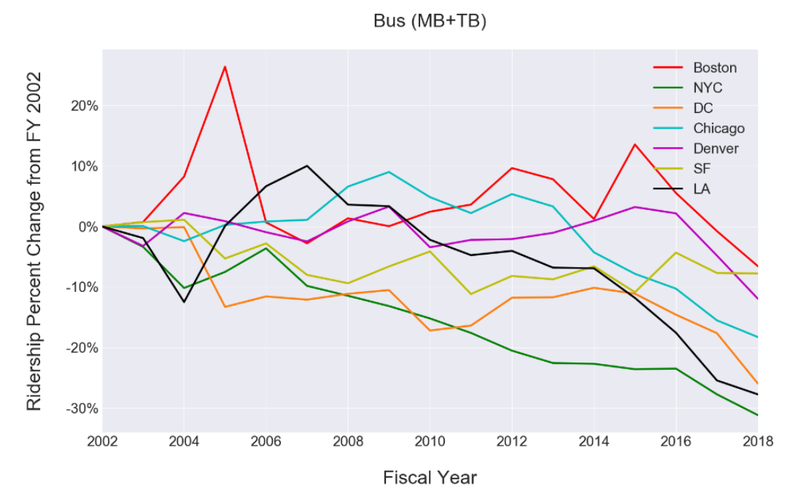
Transit Total ridership
Public Transportation has been on a nationwide trend downwards in the last decade (NTD).
Chart Taken From: “Understanding the Recent Transit Ridership Decline in Major US Cities: Service Cuts or Emerging Modes?”
ttp://usa.streetsblog.org/wp-content/uploads/sites/5/2019/01/19-04931-Transit-Trends.pdf

Slide 18
Transit Total ridership
2018 Was the Year of the Car, and Transit Ridership Felt It
“Buses — still the workhorses of public transportation in most cities — have seen some of the steepest declines in ridership over the years. Since 2013, ridership has fallen 14.3 percent nationwide, according to APTA [American Public Transportation Association] statistics. The quality of the bus service — measured by factors like frequency, on-time arrivals and overall experience — is often a significant factor influencing ridership.”
https://www.govtech.com/fs/transportation/2018-Was-the-Year-of-the-Car-and-Transit-Ridership-Felt-It.html

Slide 19
Transit Total Cost

Slide 20
Transit Total ridership

Slide 21
Transit Total Cost per ride

Slide 22
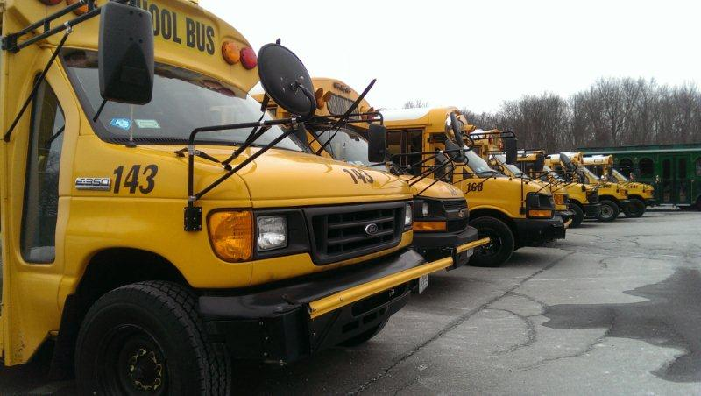
PRE-K/E.I.E.
Drop offs at schools in the following towns:
Brewster
Mahopac
Yorktown
Granite Springs
Beacon
Wappingers
Cornwall on Hudson
Briarcliff Manor
White Plains
Valhalla
From Sept 2018 thru June 2019
16 AM runs
6 Midday runs
17 PM runs
From June 2019-Aug 2019
16 AM runs
6 Midday runs
18 PM runs

Slide 23
Veterans Transportation – OSR and RSVP Program
Cost Breakdown
2018: $5,000
2017: $5,000
2016: $44,000
1411 Rides in the last 3 years, 75 Veterans serviced.
Ridership Breakdown
2018: 381 rides given to 37 Veterans
2017: 528 rides given to 40 Veterans
2016: 502 rides given to 44 Veterans

Slide 24
Mobility Management
Revamped website and information resources.
https://www.putnamcountyny.com/transportation/
https://pcny.maps.arcgis.com/apps/webappviewer/index.html?id=941492ad4823465aa1c29d1365468b4c
1 call center. Comprehensive guide to transit options in the county, work with neighboring municipalities to transfer riders, provide info
Travel training in person or over the phone i.e. first mile/last mile alternatives and eventual connection to Putnam Transit
Scheduling flexibility with on calls/constant feedback loop between Mobility Manager and Transportation Manager, MV

Slide 25
Questions?

